Slide 1
Calculating the Cost

Slide 2
Project Management Tools
Microsoft Project
Gantt Charts
Networks (AON)
Money especially the cash budget

Slide 3
















Work Breakdown structure
Table
Gantt Chart
Network
+ Resource sheet
John costs R200 / hour
Brian costs R150 / hour
8 hours of work in 1 day.
How much money per calendar week?
How much for John per week?
How much for Brian per week?

Slide 4
John costs R200 / hour
Brian costs R150 / hour
8 hours of work in 1 day.
How much money per calendar week?
How much for John per week?
How much for Brian per week?

Slide 5







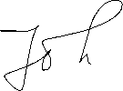







Slide 6

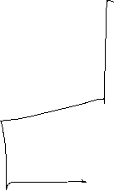


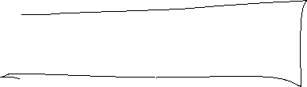








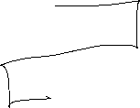

Slide 7



